Slide 1

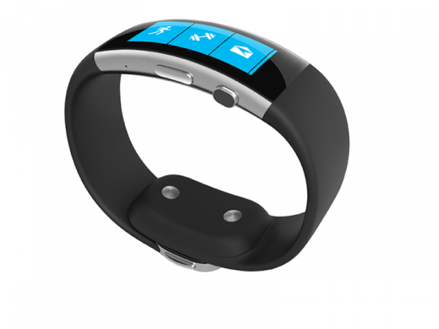


Machine learning
Storage of user data
Determine optimum room temperature
Connect to band via Bluetooth
Upload data onto web
Get feedback from user
Heartrate
Accelerometer
Skin temperature
Galvanic skin response
Show statistics
Push notifications to app when time to sleep
Social network integration

Slide 2

S
e
f
e
p
i
y

Slide 3


Slide 4


Heartrate
Accelerometer
Skin temperature
Galvanic skin response
Connect to band via Bluetooth
Upload data onto web
Get feedback from user
Machine learning
Storage of user data
Determine optimum room temperature
Show statistics
Push notifications to app when time to sleep
Social network integration

